Slide 1

Olist Analysis Project
E-commerce Analysis Using Python (Pandas, Matplotlib, Seaborn)
Abdelrhman Amer

Slide 2
Project Overview
This project analyzes data from the Olist e-commerce dataset, focusing on
customer behavior, sales trends, delivery times, and payment methods.
The goal is to extract meaningful insights that could drive business decisions
for Olist's partners and vendors.
Tools used:
Python (Pandas, Matplotlib, Seaborn)
SQL (for data extraction and cleaning)

Slide 3
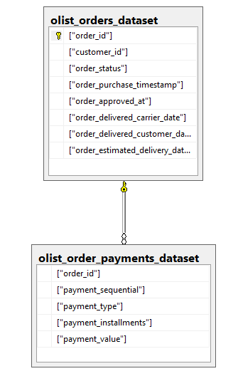
Data Sources
The dataset is publicly available on Kaggle and contains 100K+ orders from 2016 to 2018.
Tables used:
Orders Dataset: Contains details about each order.
Customer Dataset: Information on customers.
Order Items Dataset: Details of individual items in each order.
Products Dataset: Product-related information.
Sellers Dataset: Data about sellers.
Reviews Dataset: Customer feedback on orders.
Payments Dataset: Payment information for each order.
Geolocation Dataset: Location data for customers and sellers.

